Slide 1



CNS PROJECT
TEAM MEMBERS:​
K. SREEVARUN(2010030451)​
E. PAVAN SAI(2010030538)​

Slide 2


FTP CONNECTION

Slide 3
Outline:
Introduction
Implementation
Git Hub Commits
Beta Testing

Slide 4

Introduction
File Transfer Protocol (FTP) is a communications protocol used to send files from computer to computer, with one of them acting as the server, providing the two have an Internet connection.
A networking protocol between client and server, FTP allows users to download web pages, files, and programs that are available on other services.
An FTP server is a computer program that is built to handle data transfer between computers. The server waits for clients to connect to it and issue commands that tell the server to upload, download, or list directories. The FTP protocol is the commands the FTP server uses to accomplish this.

Slide 5

Implementation

Slide 6
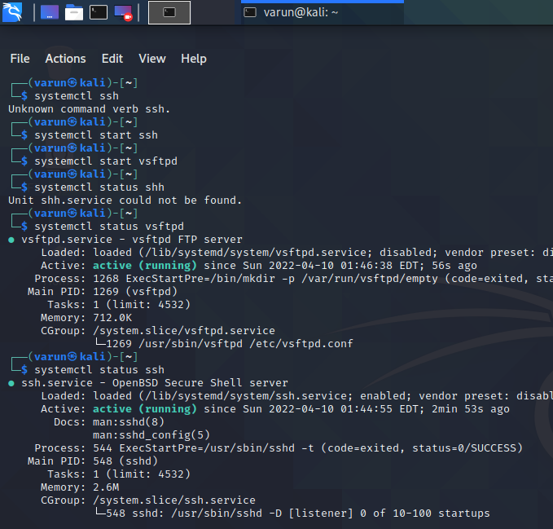
Starting ssh and ftp servers & checking their status

Slide 7
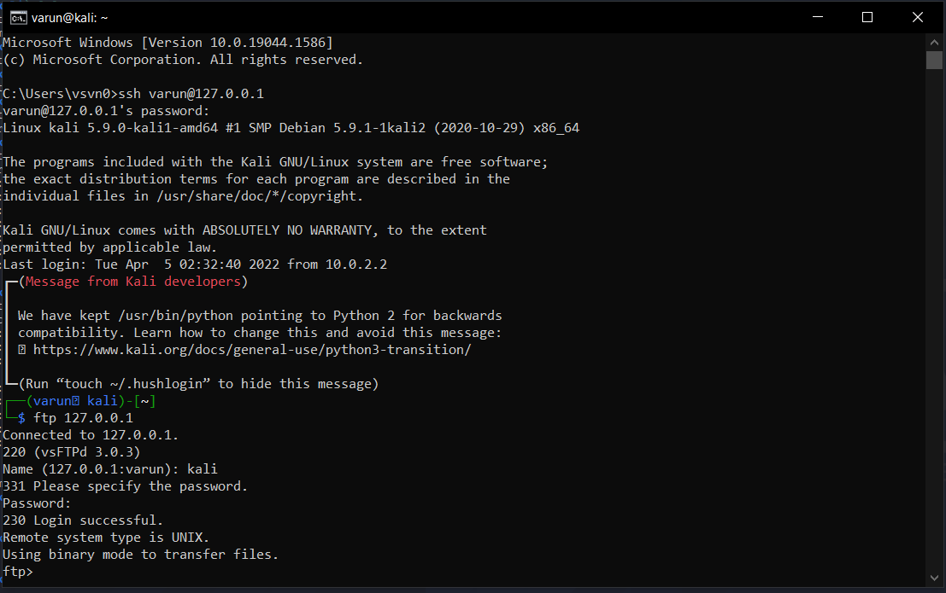
Connecting ftp sever in command prompt

Slide 8
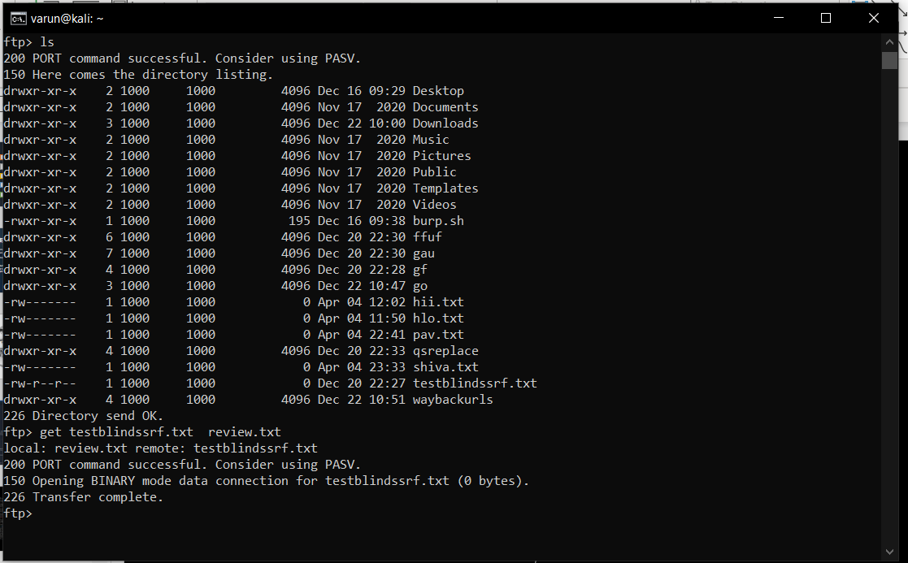
Transferring file

Slide 9
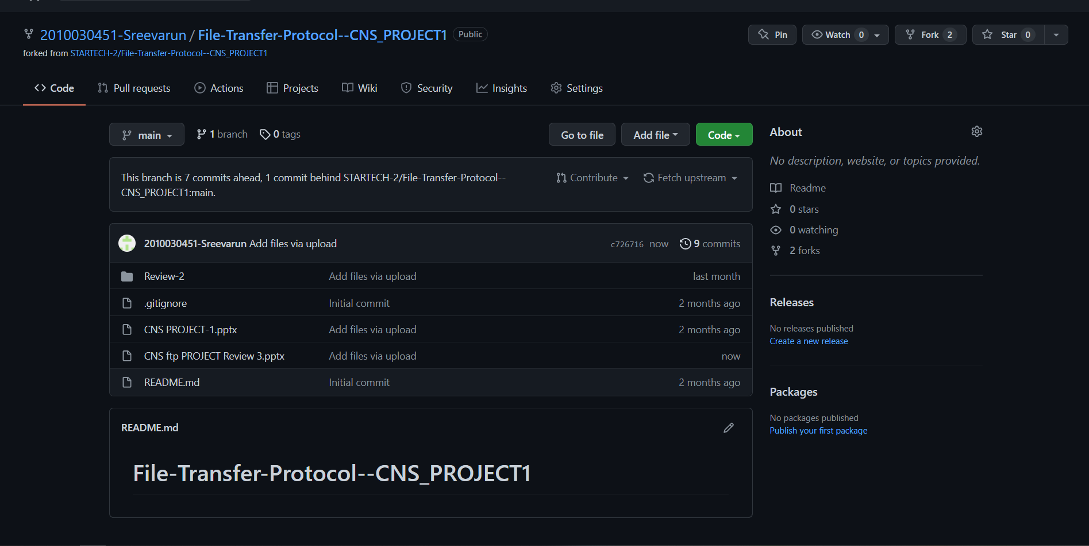
GIT HUB COMMITS

Slide 10
Beta Testing

Slide 11
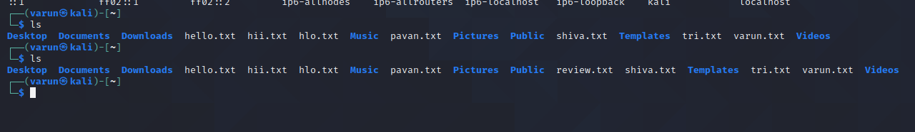
Successfully transferred

Slide 12


